Slide 1
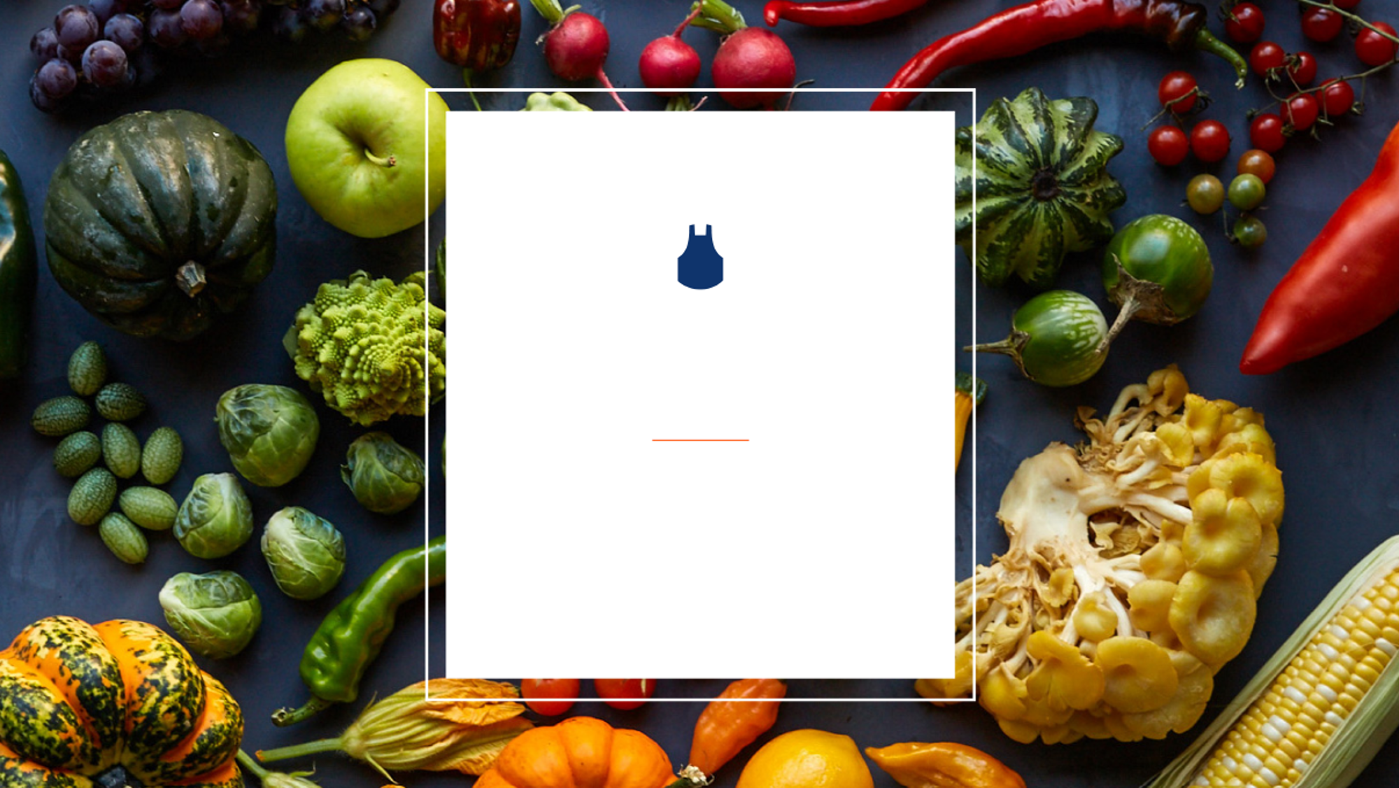
Blue Apron Steering Committee #1
April 26 2019
Prepared by: Nick Caldicott, Carmin Ballou, Helen Wang, Mimi Chakraborty
Notes:
Carmin
Default font: Arial; 20
Default color of text box: RGB(127,127,127)

Slide 2
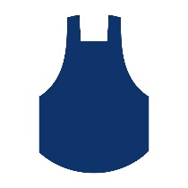
Agenda
Industry
Competitors
Company Background
Customers
Summary
Notes:
Carmin

Slide 3

Industry
Notes:
Nick

Slide 4



Meal Kits
Meal Kit Industry
Number of startups to enter the meal kit industry***
+150
Low barriers to entry
Consumers who purchased a meal kit in the last six months of 2018*
14.3 Million
+36% YoY
$3.1 Billion
Meal Kit market sales in 2018**
+22% YoY
Restaurants
In-store meal kit household growth in 2018*
2.2 Million
60% of total growth
Food Delivery
$100 Million
Investor Funding in 2018***
-77% Since 2015
Supermarket
Profitable meal kit subscription companies
0
Grocery Delivery
High operating costs and low repeat purchases
Total Food & Beverage
*Source: Nielsen Homescan Panel Custom Survey, Oct. 22-Nov. 12, 2018, and Nov. 30-Dec. 25, 2018; U.S. Census 120 million households, December 2017.
**Source: Packaged Facts
***Source: CB Insights, Food & Beverage Trends
Notes:
Nick
You can define the industry in many ways. Small online meal kit subscription service or part of a larger food and beverage universe.
The numbers on the left here tell the story of where the industry is going.
People are eating at home more often and people looking for fresher options.
Meal kits exploded in 2015 as investors poured nearly half a billion dollars in the category. Funding has declined rapidly since then from $450 Million in 2015 to $100 Million in 2018.
More than 150 companies have jumped into the meal kit industry with low barrier to entry
Industry is faced with high costs given expensive supply chain, heavy discounts to new shoppers, portioning and packaging individual ingredients, etc.
Tried to grow too quickly
Fresh has been slower to move online, making DTC meal kits appealing
Average growth is 13.8% per year from 2018-2023.
14.3 million households purchased meal kits in the last six months of 2018.
Households saying they would consider purchasing a meal kit within the next six months.
Major trend: Meal kits have emerged as a promising marketing tactic for grocery retailers and a path for growth for meal kit services.
60% of the growth in meal kits was due to in-store meal kit sales.
Overview, structure, and trends. Use Helen’s broader frame of reference slide.
Source: Packaged Facts, 2018 Food Report
https://www.recode.net/2018/3/26/17165030/hellofresh-blue-apron-meal-kit-delivery-marketshare-acquisition-organic-green-chef

Slide 5
Competitors
Notes:
Nick

Slide 6
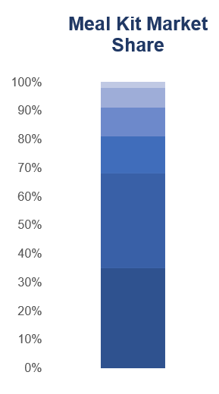
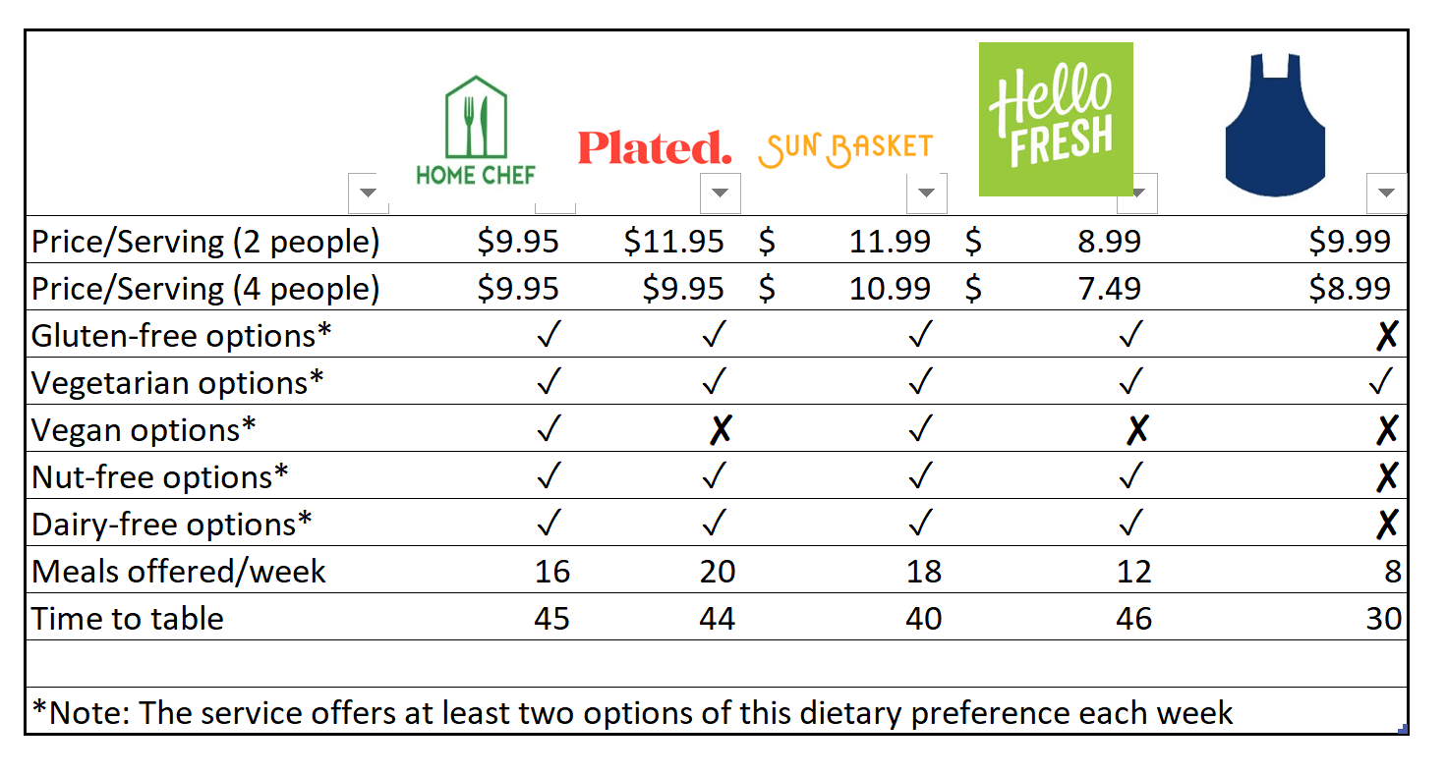

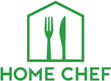

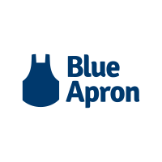
Competitors
7%
10%
13%
33%
35%
*As of February 2018
*Source: https:www.blueapron.com
**Source: https://www.reviewed.com/cooking/best-right-now/the-best-meal-kit-delivery-services and Blue Apron website.
***Source: https://www.recode.net/2018/3/26/17165030/hellofresh-blue-apron-meal-kit-delivery-marketshare-acquisition-organic-green-chef
Notes:
Nick
These are all the closest competitiors
Big call outs as you compare Blue Apron to the other major competitors is that is lacks breadth and depth of variety in its weekly meal options
Home Chef
Best Overall
The best meal kit subscription delivery service for you is probably Home Chef.
High-quality ingredients, well-written recipes, and fantastic flavors make the Home Chef experience one you’ll want to integrate into your weeknights—and the service’s organization makes it incredibly easy to do so. You may just impress yourself with how good your Home Chef meals turn out.
See Home Chef's plans and pricing
Plated
Best for Families
Whether you’re cooking for picky eaters or need a plan that fits into your busy schedule, Plated can probably help you. The service’s large portions, huge recipe variety, and cook time accuracy make it our top choice for families—or those of us who love to have leftovers.
See Plated's plans and pricing
Sun Basket
Best for Vegetarians
While not an entirely vegetarian service, Sun Basket offers a huge variety of quick, flavorful plant-based meals that will satisfy vegetarians and omnivores alike. Their ingredients are largely organic, and their recipes are some of the fastest we tested.
See Sun Basket's plans and pricing
HelloFresh
Meal kit giant HelloFresh featured our very favorite recipe of the entire experience and earned high marks for flavor overall. While their recipes weren’t always quick to make, I always had fun in the process.
See HelloFresh's plans and pricing
https://www.reviewed.com/cooking/best-right-now/the-best-meal-kit-delivery-services
Carmin will add Blue Apron to table

Slide 7




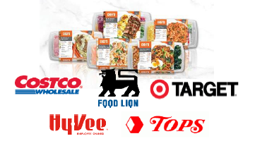

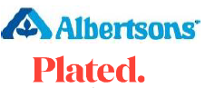
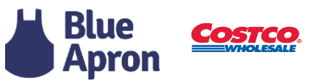



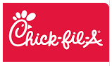




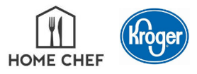


Meal Kits & Beyond
Rollout
Partnership
Acquisition
Acquisition
Rollout
Rollout
2017
2018
Today
Introduces meal kits
Partnership
Rollout
Acquisition
Acquisition
Introduces meal kits
Grocery Delivery
Acquisition
Rollout
*Source: L.E.K. Research & Analysis
**Source: Nielsen Annual Meat Conference, 2019
Rollout
Notes:
Nick
You can see that these same competitors are working hard to create retailers relationships and acquisitions that can help scale their platforms
Call out Amazon/Whole Foods
Call out Blue Apron + Costco
Call out Chef’d for most retailer partnerships
Nielsen 2018
November - Blue Apron meal kit distribution with Costco is on hold

Slide 8
Company Background
Notes:
Mimi

Slide 9
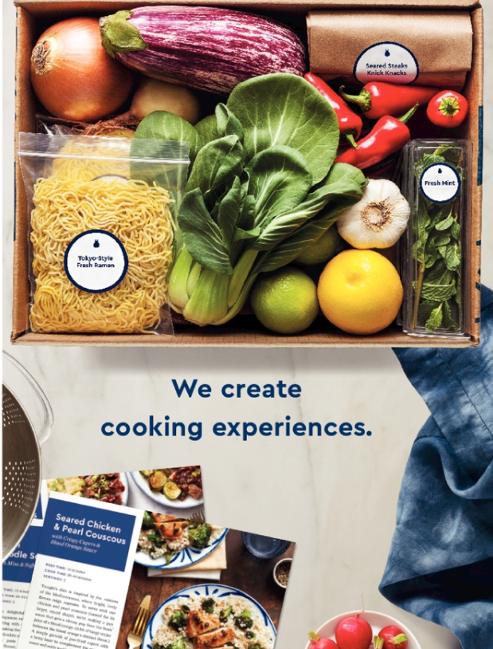
Blue Apron: A meal kit service company
Mission
Blue Apron's mission is to make incredible home cooking accessible to everyone
Vision
Our vision for the future is ambitious: to build a better food system. Blue Apron is transforming the way that food is produced, distributed, and consumed. They believe a better food system will benefit not only consumers and stockholders, but also the planet, and they manage their business for the benefit of all three.
Value
“We win together, not alone.
We start from “yes”.
We seek growth and learning, not perfection.
We operate with integrity.
We are accountable.”
Source: https://www.sec.gov/Archives/edgar/data/1701114/000104746917004287/a2232570zs-1a.htm
Notes:
Mimi: https://www.sec.gov/Archives/edgar/data/1701114/000104746917004287/a2232570zs-1a.htm

Slide 10
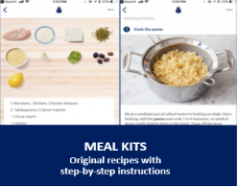
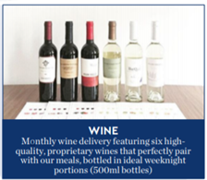
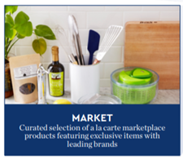
Products
Risks and Issues
Logistics and Operational Challenges
Customer Acquisition and Retention
Supplier cost and Seasonality fluctuations
External Factors including climatic condition and political changes
Food Safety
Source: https://www.sec.gov/Archives/edgar/data/1701114/000104746917004287/a2232570zs-1a.htm
Notes:
Mimi

Slide 11
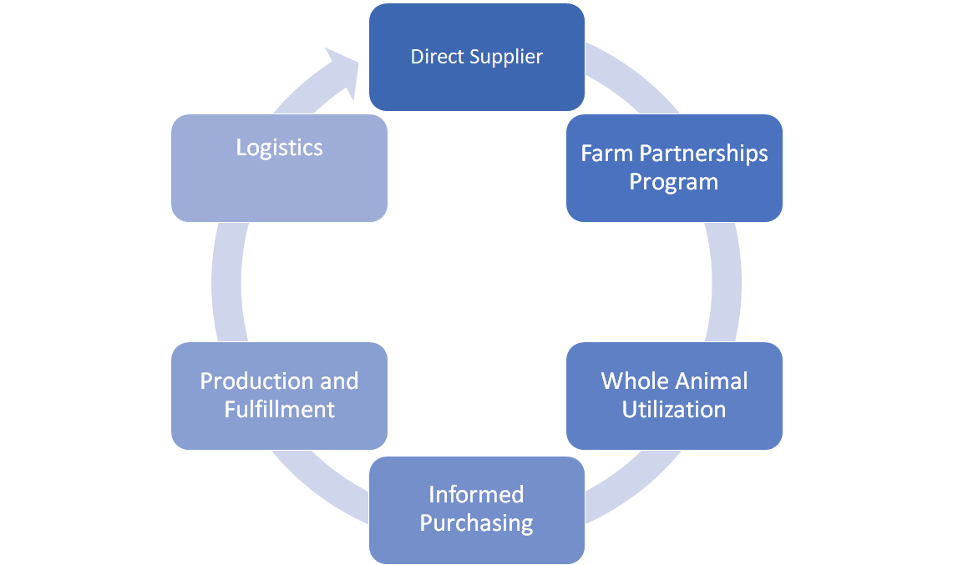
Suppliers & Operations
Source: https://www.sec.gov/Archives/edgar/data/1701114/000104746917004287/a2232570zs-1a.htm
Notes:
Mimi

Slide 12
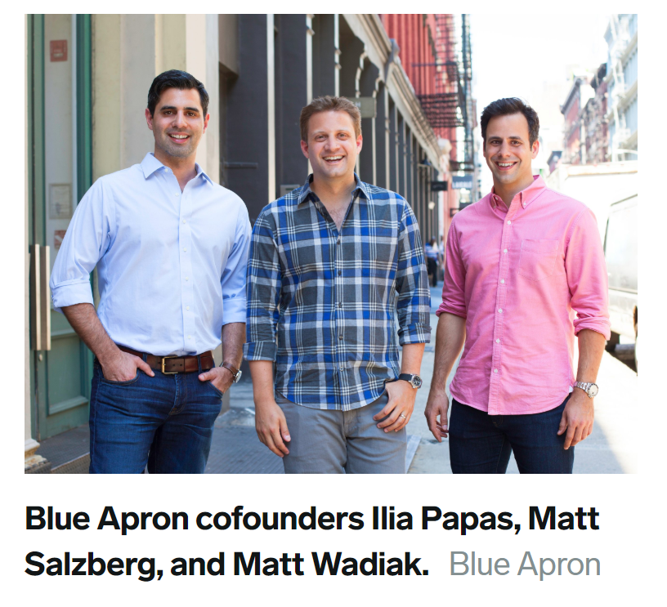
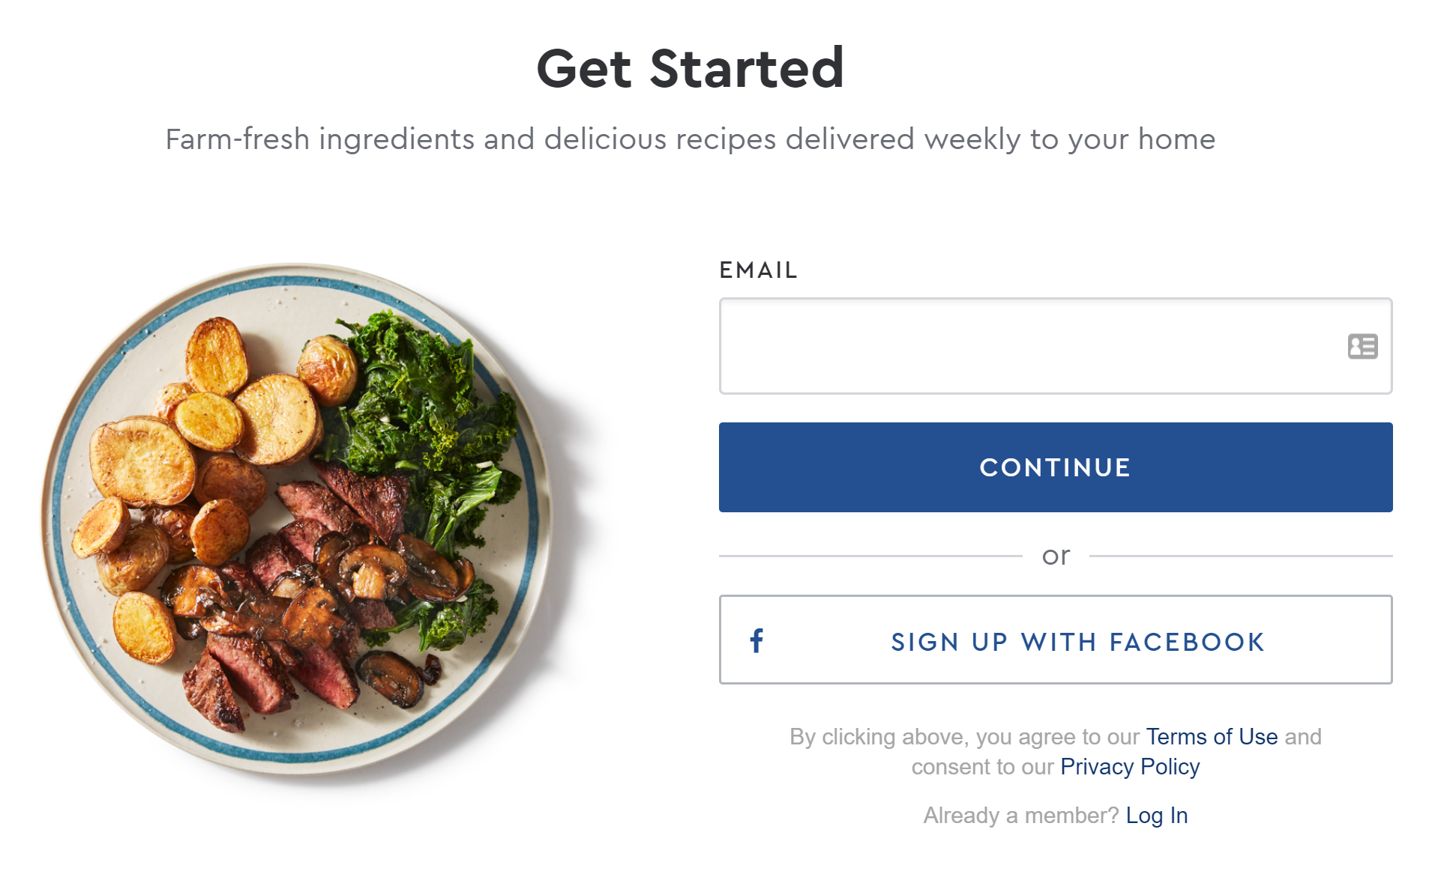
Company Structure
History
Founded in 2010 by a chef, an engineer and a venture capitalist.
Current Management
April 2, 2019 new CEO, Linda Findley Kozlowski
Tim Bensley, CFO (joined in May 2018)
COO: Alan Blake focused on streamlining operations
Last Founder, Papas, leaving in May
Operational Streamlining
Reduction in Labor Force
Moving more operations to New Jersey
Technology Overview
Engineering-software that runs/supports supply chain operations
Front-end Software-apps & website that are consumer facing
Enterprise System-technology that supports the support activities.
Source: Blue Apron website; Blue Apron Press Release dated January 30, 2019
Notes:
Product, technology, general, and administrative (PTG&A) costs decreased 15% year-over-year from $53.3 million in the fourth quarter of 2017 to $45.4 million in the fourth quarter of 2018, as the company remained focused on expense management and optimization of its cost structure.
A big focus of the investor report of the past year.
Transferring substantial production volume from its Arlington, Texas facility to its Linden, New Jersey facility, driven by strong efficiency gains in Linden. (https://investors.blueapron.com/press-releases/2019/01-30-2019-212321187)
Efficiency of the operations seems to be driven by automation (https://investors.blueapron.com/~/media/Files/B/BlueApron-IR/reports-and-presentations/raymond-james-transcript-12032018-formatted.pdf)

Slide 13
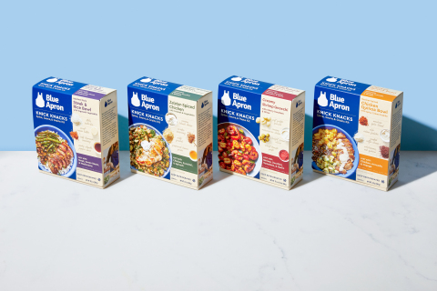

Revenue Growth Strategy
Increase market penetration with our core product
Expand our core product to fit more lifestyles
Broaden our product portfolio
Develop new brands and new channels
International expansion
KPI | 6/30/2018 | 9/30/2018 | 12/31/2018
Average Order Value | 57.34 | 56.79 | 58.12
Orders per Customer | 4.4 | 4.1 | 4.3
Avg. Revenue Per Customer | 250 | 233 | 252
Source: Blue Apron Holdings Inc, 2018 10-K SEC Filing
Notes:
KPI Definitions:
Orders
We define Orders as the number of paid orders by our Customers across our meal, wine and market products sold on our e-commerce platforms in any reporting period, inclusive of orders that may have eventually been refunded or credited to customers.
Customers
We determine our number of Customers by counting the total number of individual customers who have paid for at least one Order from Blue Apron across our meal, wine or market products sold on our e-commerce platforms in a given reporting period.
Average Order Value
We define Average Order Value as our net revenue from our meal, wine and market products sold on our e-commerce platforms in a given reporting period divided by the number of Orders in that period.
Orders per Customer
We define Orders per Customer as the number of Orders in a given reporting period divided by the number of Customers in that period.
Average Revenue per Customer
We define Average Revenue per Customer as our net revenue from our meal, wine and market products sold on our e-commerce platforms in a given reporting period divided by the number of Customers in that period.

Slide 14
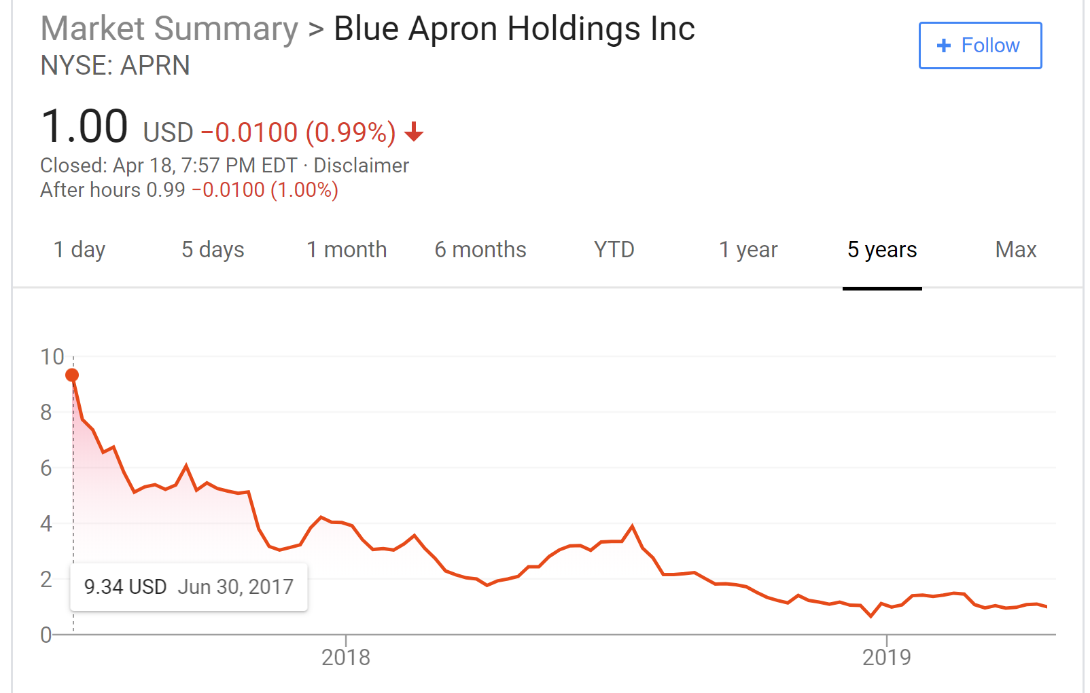
Financial Overview
IPO: 2017
Pre-IPO valuation was $2B
Balance Sheet (12/31/2018):
Total Assets: $355M
Total Liabilities: $244M
Shareholder’s Equity: $119M
Cash at 12/31/2018: $95M
Struggling with profitability:
 | 2016 | 2017 | 2018
Revenue | $795,416 | $881,191 | $667,600
Expense | $782,978 | $1,069,951 | $850,219
Net Income | ($54,803) | ($188,760) | ($114,378)
EBITDA | ($43,621) | ($137,939) | ($61,371)
Source: Blue Apron Holdings Inc, 2018 10-K SEC Filing

Slide 15
Customers
Notes:
Mimi

Slide 16
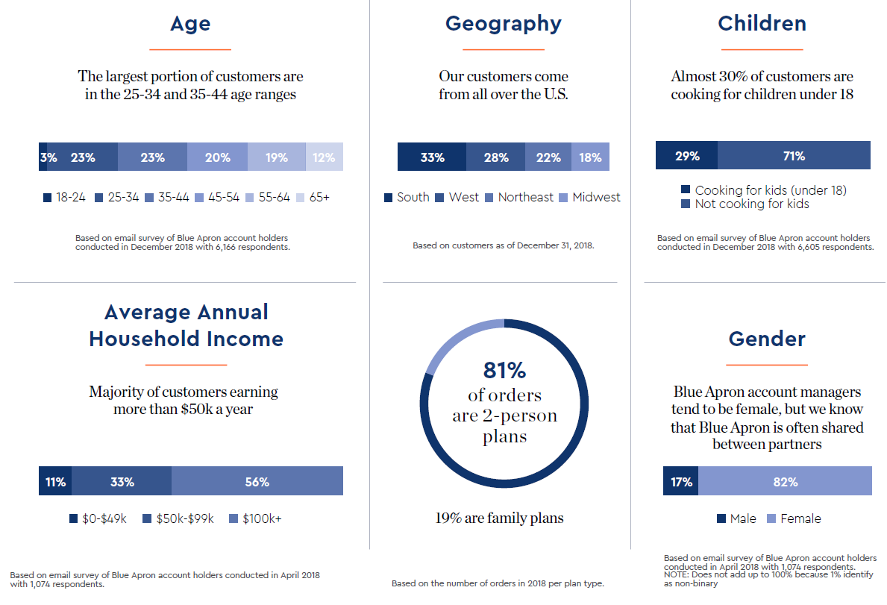
Customer Demographics
Who are Blue Apron’s customers?
The Enthusiast: “Help me feel challenged and fulfill my passion for cooking.”
The Aspirer: “Help me make cooking a part of my busy and hectic life.”
The Avoider: “Help remove the burden of cooking.”
* Source: Blue Apron Holdings Inc, 2018 10-K SEC Filing

Slide 17
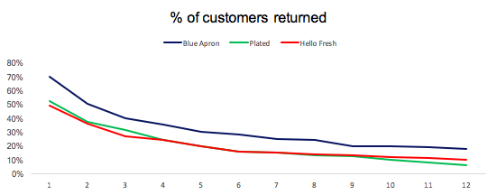
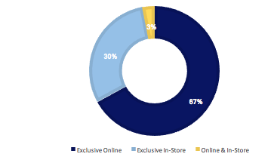
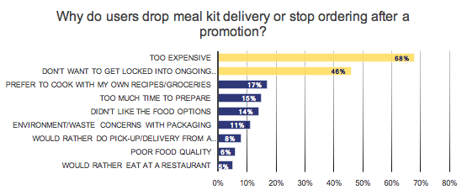
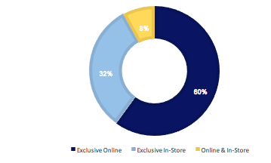
Customer Retention
Meal kit industry is currently facing diminishing retention rate due to the fact that many customers shifted to in-store purchase
2017
2018
* Source: Nielsen Homescan Panel Custom Survey, Oct. 22 - Nov. 12, 2018, and Nov. 30 - Dec. 25. 2017.
**Source: Cleveland Research Company, Online Food Consumer Research Study, 2018
***Source: Second Measure

Slide 18
Summary
Notes:
Mimi

Slide 19
Summary
Delivery meal kits have seen rapid growth, but price matters in the purchase decision (#1 reason customers leave) and competition is fierce
Some delivery meal kit model issues are alleviated with in-store meal kits which have higher margins, allowing competitors to squeeze Blue Apron
Blue Apron must find new paths to growth and profitability
There are still unmet needs with opportunity for meal solutions but the economics are not favorable for a high cost solution
Notes:
Insights & Challenges

Slide 20
Thank You
Notes:
Carmin
Default font: Arial; 20
Default color of text box: RGB(127,127,127)

Slide 21
Appendix
Notes:
Mimi

Slide 22
Appendix
Blue Apron faces a lot of direct competition*, which is part of the reason it’s stock price has struggled. Here are four of its main competitors:
HelloFresh far surpasses Blue Apron's variety with 15 recipes each week, plus the customizable Fit, Quick and Variety plans
Features vegetarian, gluten-free, nut-free and vegan options
Offers 18 meal options every week, much more than Blue Apron's 6 weekly options for couples, and 4 for families
Specialty meal plans include gluten-free, vegetarian, dairy-free, low-calorie, low-carb, and more
Premium meals available for special occasions
A whopping 20 recipes to choose from each week, which is more than Blue Apron and just about every other meal delivery service out there
All protein is raised hormone-free and antibiotic-free; Flexible plans so you can change your delivery schedule or skip days; All recipes use fresh and seasonal produce
All of Sun Basket's produce is organic and non-GMO, whereas only some of Blue Apron's ingredients are certified organic
All recipes are developed by an award-winning chef, Justine Kelly, and are nutritionist-approved

Slide 23
Appendix
•Direct Supplier Relationships - Eliminating middlemen and collaborating directly with farmers on crop planning and production to provide fresh ingredients
•Farm Partnerships Program - Sharing tools and insights to enable suppliers to improve their efficiency, promote agricultural practices that prioritize long-term health of the farmland, and produce high-quality ingredients
•Whole Animal Utilization - Collaborating with farmers and ranchers to utilize whole animals instead of individual cuts, giving them the ability to provide premium products to the customers, reduce volatility for suppliers, and help insulate them from market fluctuations in prices.
•Informed Purchasing - Place purchase orders closer to the delivery date, after coordinating supply and demand through processes such as recipe merchandising and analyzing the outputs of demand planning tools.
•Production and Fulfillment - Fulfillment centers are engineered to manage variable, high-throughput, perishable inventory as well as flexible production and labor needs
•Logistics - Analyze outbound logistics on a zip code by zip code basis to enable cost-effective and timely delivery of orders, also adjusting the packaging of ingredients and other components of the fulfillment operations based on the expected delivery route, weather, or ultimate destination.

Slide 24
Appendix
Risks and Issues
•Effective customer acquirement and retaining existing customer
•Manage future growth effectively
•Food safety and foodborne illness incidents through lawsuits or enforcement actions exposures, increasing operating costs, and reducing demand for product offerings
•Brand image maintenance
•Change in consumer taste and preference
•Changes in food and supply costs and availability
•Season fluctuations in operating results
•Increased competition presents an ongoing threat to success
•Successfully build out and operate fulfillment centers and logistics channels by expanding use of automation
•Source quality ingredients and other products is critical to the business, any disruption to supply or supply chain could materially adversely affect business
•Reliable and cost-effective storage, transport and delivery of perishable ingredients and other products
•Higher labor costs due to statutory and regulatory changes
•Natural disasters, public health crises, political crises or other catastrophic events.

Slide 25
Appendix
KPI Definitions:
Orders
The number of paid orders by our Customers across our meal, wine and market products sold on our e-commerce platforms in any reporting period, inclusive of orders that may have eventually been refunded or credited to customers.
Customers
Counting the total number of individual customers who have paid for at least one Order from Blue Apron across our meal, wine or market products sold on our e-commerce platforms in a given reporting period.
Average Order Value
Average Order Value as our net revenue from our meal, wine and market products sold on our e-commerce platforms in a given reporting period divided by the number of Orders in that period.
Orders per Customer
Orders per Customer is the number of Orders in a given reporting period divided by the number of Customers in that period.
Average Revenue per Customer
Average Revenue per Customer is ther net revenue from our meal, wine and market products sold on our e-commerce platforms in a given reporting period divided by the number of Customers in that period.
Source: Blue Apron, Investor Presentation, 2018

